Slide 1
What’s Happening in my Neighborhood?
An exploration into Nashville’s growth
by Lori Butler

Slide 2
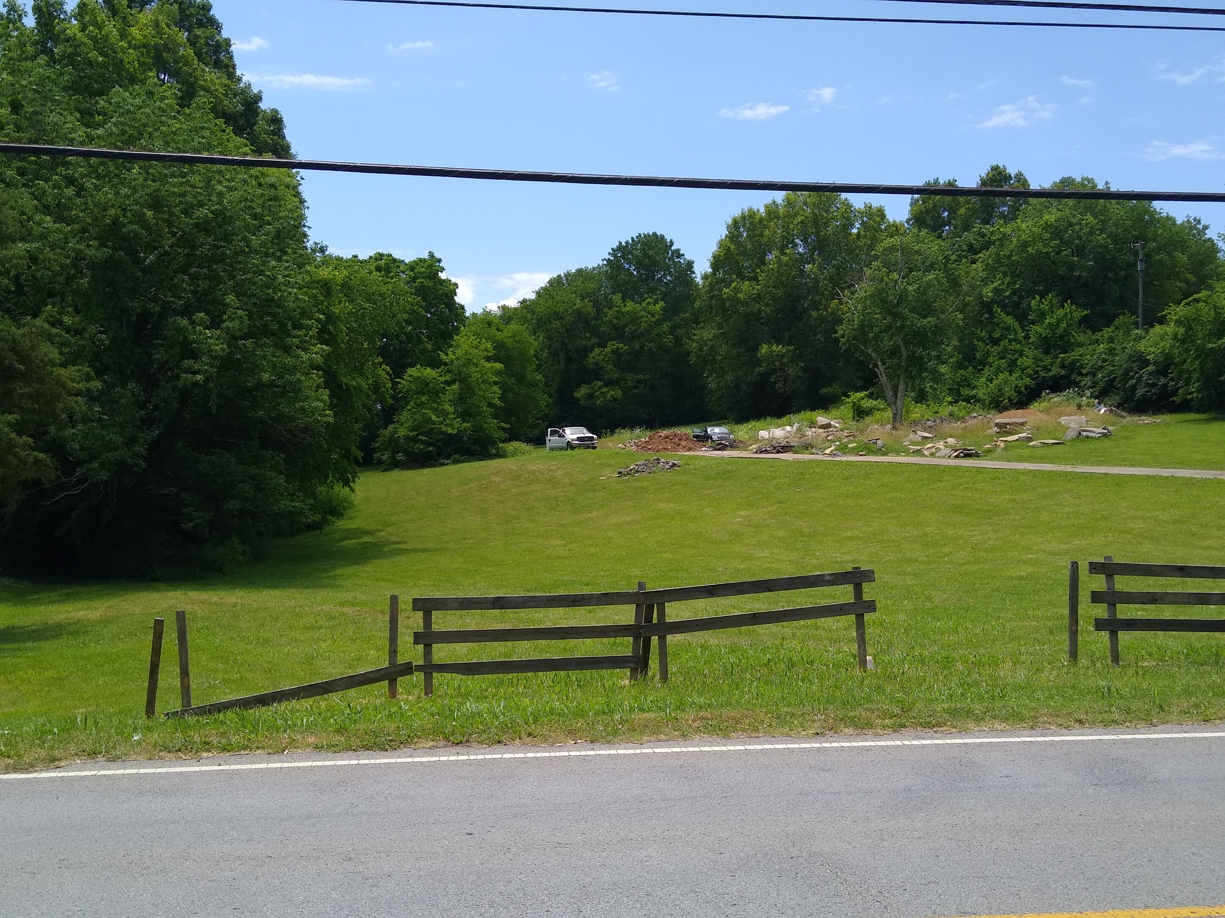
My Motivation
The Lot Next Door
2.3 acres
2014 sold for $60k
2017 sold for $130k
2019 sold for $219k !!
Attempted: 24-unit apartment complex
Clarksville Pike Widening
Two-mile segment
Four lanes
From 2019-2023
Image of Widening Project
(placeholder)

Slide 3
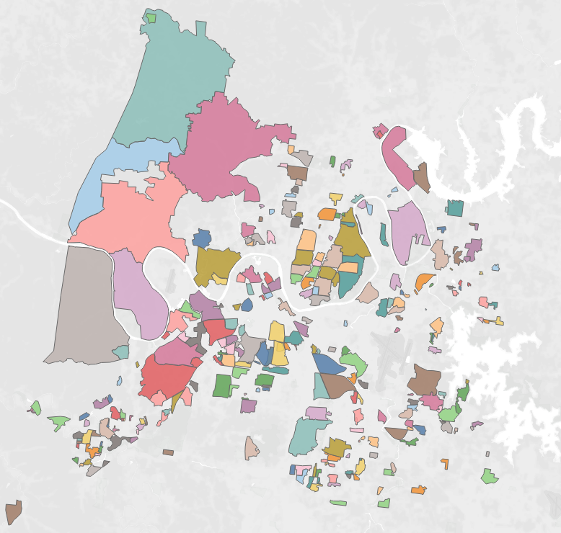
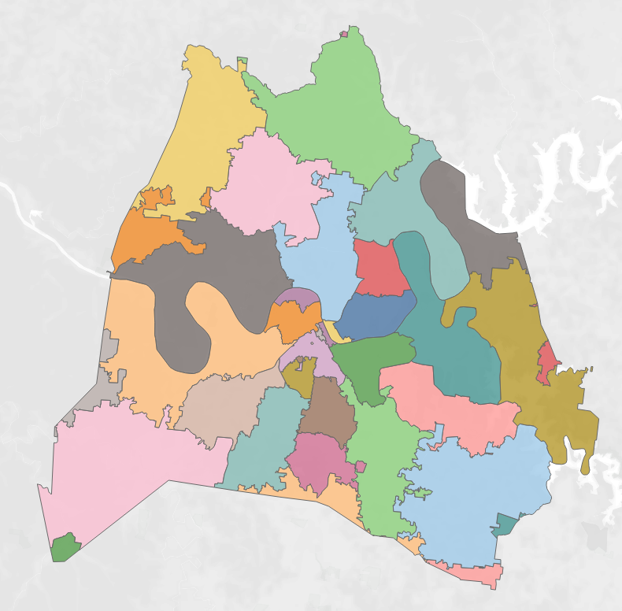
How?
“Since all related factors associated with the construction of a building are important economic activities (for example, financing and employment), the building permit report can give a major hint as to the state of the economy in the near future.”
https://www.investopedia.com/terms/b/building-permits.asp
GOOD: Neighborhood Associations
BETTER: Zip Codes
BEST: Regions

Slide 4
Data Sources

Slide 5
Data Challenges

Slide 6
next

Slide 7
next

